Slide 1


The EV Futures
Brian Matsiko

Slide 2






EU and California recently rolled out plans to phase internal combustion cars by 2035.
Currently there are four publicly traded fully electric vehicle manufacturing companies.
Business Problem
Goal of this project is to analyze the current stock and forecast futures of the four companies.
Evaluate whether the greater world are onboard with the new future of only electric vehicles
2

Slide 3


Data Overview
Source
Background
Stocking trading information was sourced from the yahoo API.
Entire trading history was included in this project.
TSLA is the only company based in North America and the other three companies are based out of China.
TSLA has been trading for 12 years
NIO has traded for 3 years
Both LI and XPEV have only been trading for a year
3

Slide 4


Exploratory Data Analysis

Slide 5

Feature Correlations With Price Close
TSLA
LI
Correlation of Close
Correlation of Close
NIO
XPEV
Correlation of Close
Correlation of Close

Slide 6

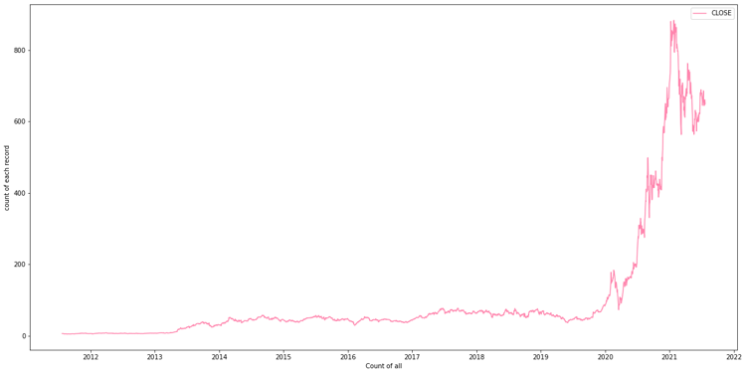
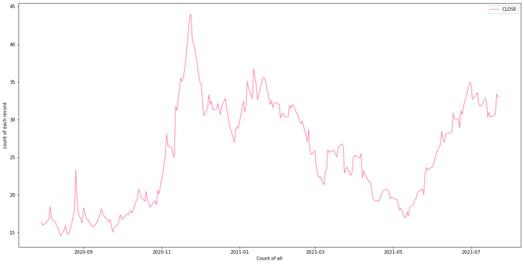
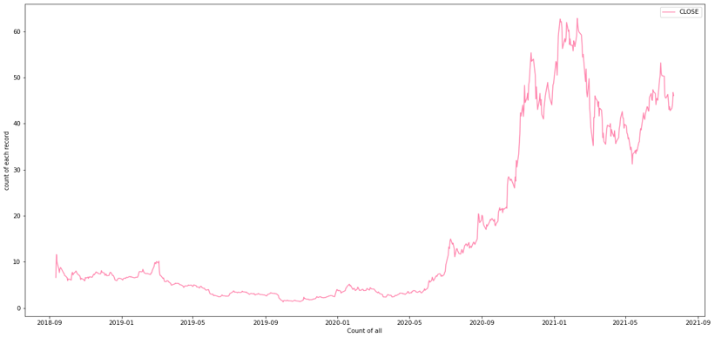
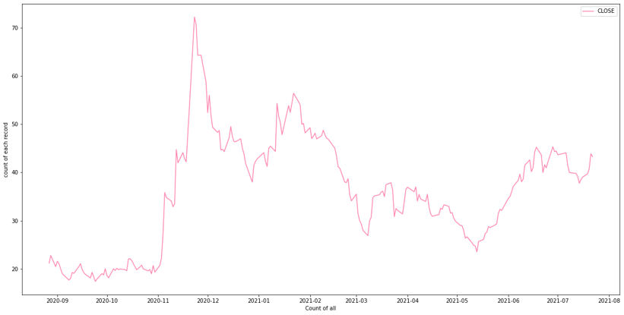
Stock Trading Trends
TSLA
LI
NIO
XPEV
6

Slide 7
Machine Learning Process

Slide 8






Target And Features
Modelling
Models
Target
Baseline LSMT model
Facebook Prophet, ARIMA and SARIMA models
Daily Stock Closing prices
Process Overview
Features and Transformations
Evaluation metrics
Mean Absolute Error (MAE)
Mean Squared Error (MSE)
Open, low, high, volume
Data time series split into train and test -70% to 30%

Slide 9
First Simple Models With LSMT

Slide 10
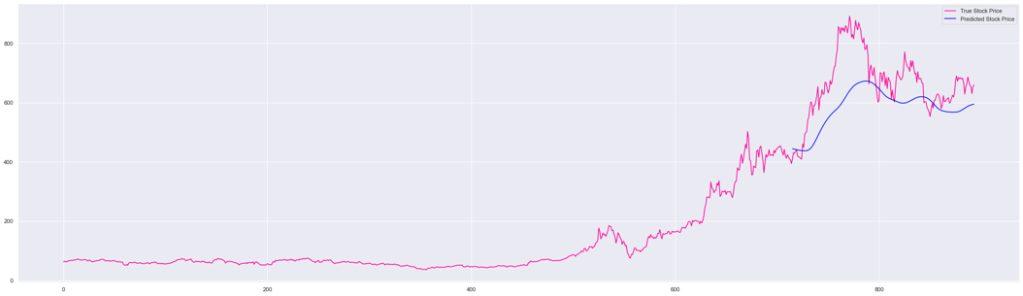
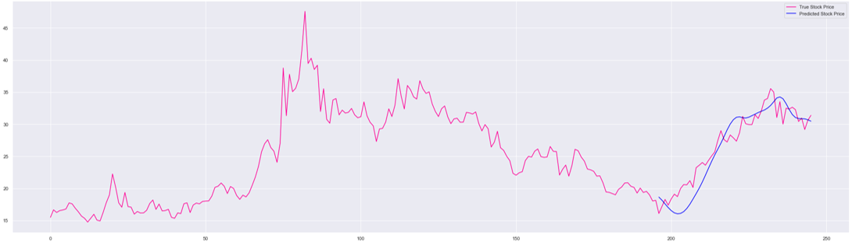
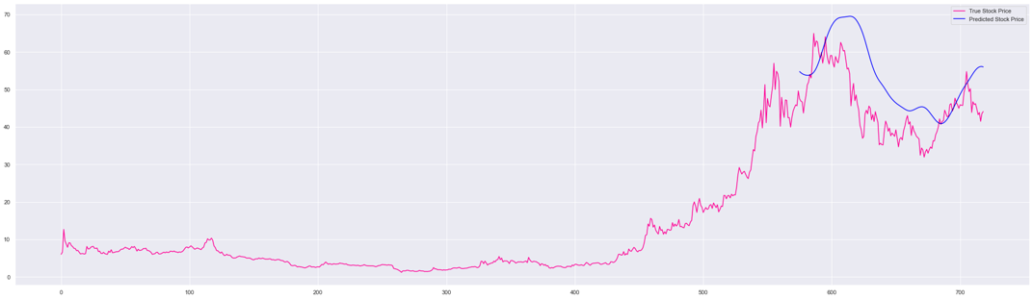
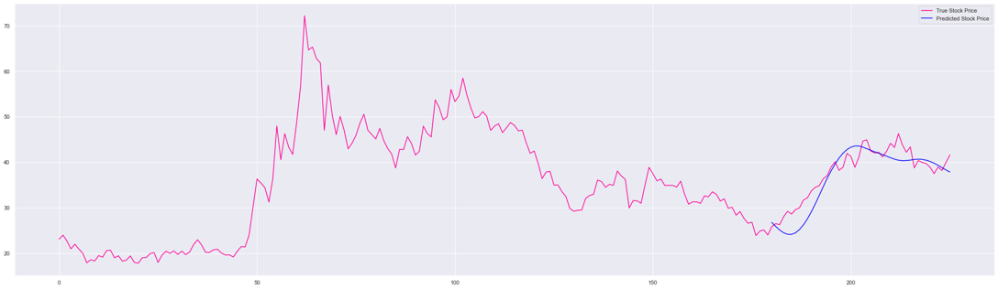
First Simple Models With LSMT
TSLA
LI
Mean Absolute Error - $91.2
Mean Absolute Error - $1.72
NIO
XPEV
Mean Absolute Error - $8.65
Mean Absolute Error - $2.27
10

Slide 11
Facebook Prophet Models

Slide 12
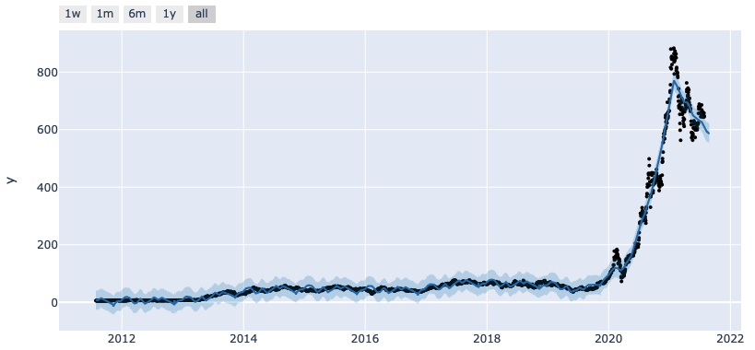
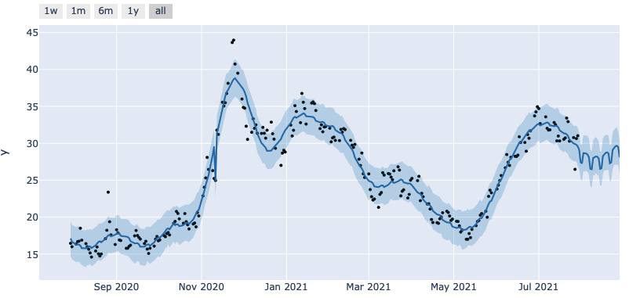
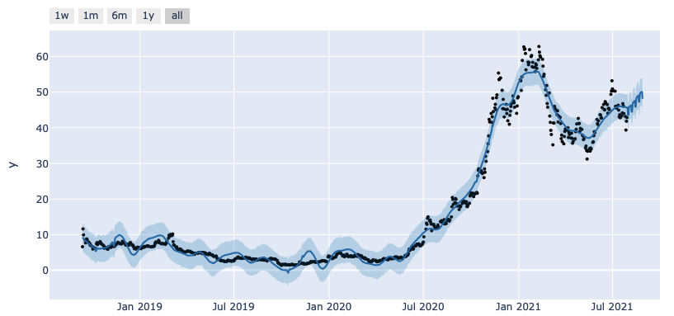
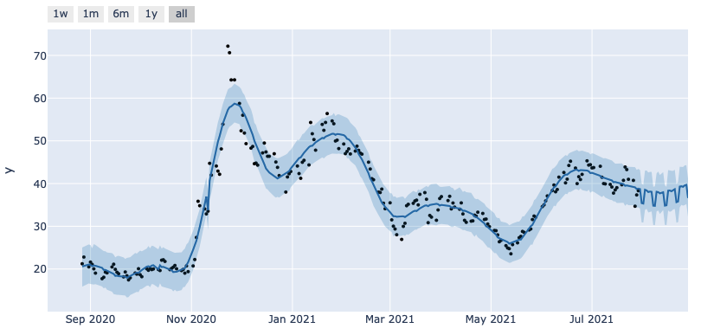
Facebook Prophet Model Predictions
TSLA
LI
Mean Absolute Error - $45.2
Mean Absolute Error - $6.48
NIO
XPEV
Mean Absolute Error - $6.11
Mean Absolute Error - $6.24
12

Slide 13
Final Model

Slide 14


SARIMA
Overall Had the best evaluation metrics
MSE
MAE
Sample Metrics represent the model on TSLA stock
14

Slide 15
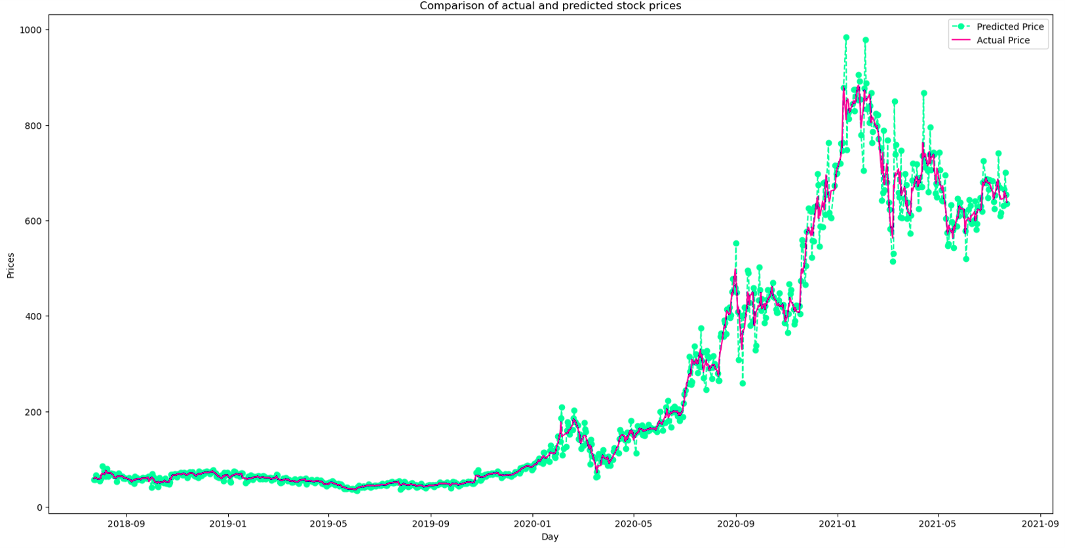
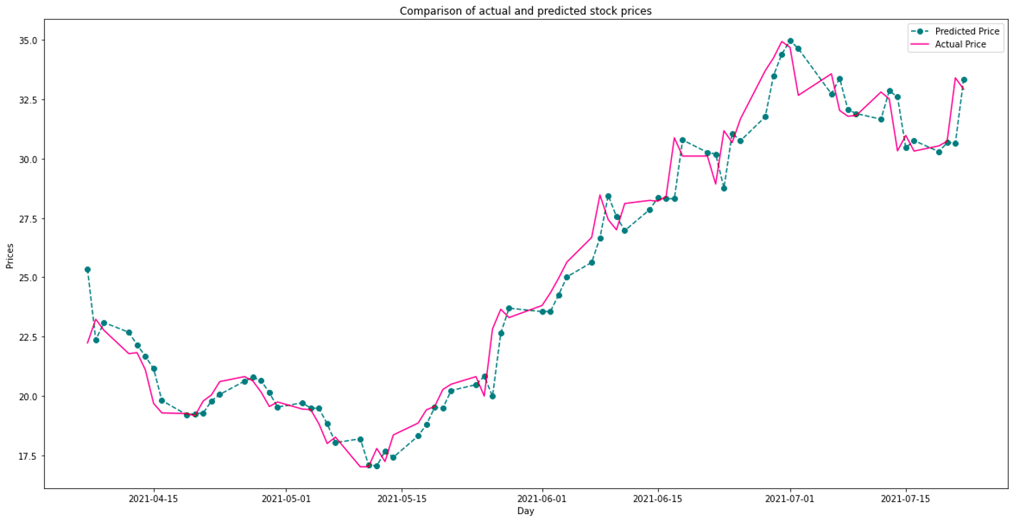
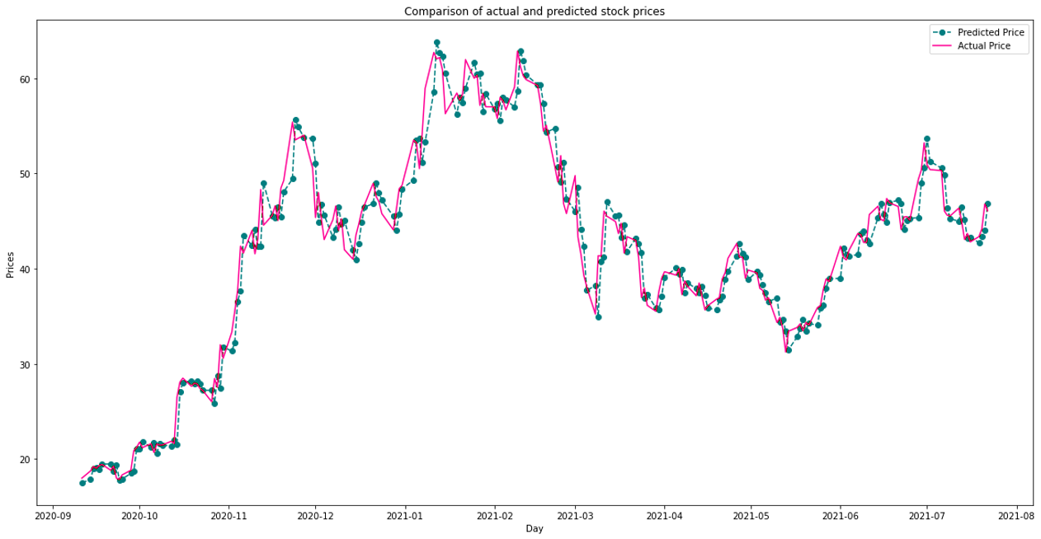
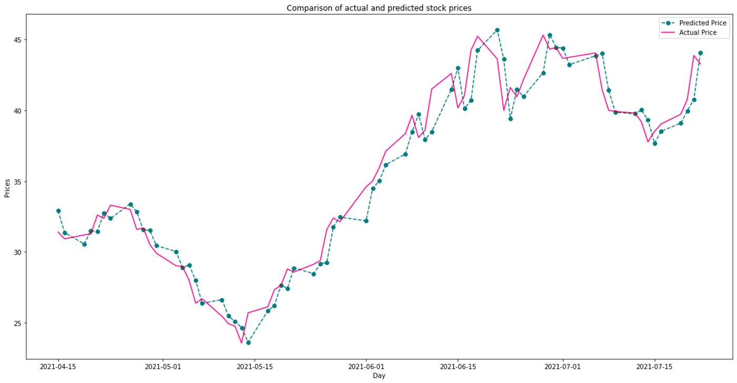
SARIMA
Overall Had the best evaluation metrics
SARIMA TSLA Actual Vs Predicted Stock Prices
SARIMA LI Actual Vs Predicted Stock Prices
MAE – $7.88
MAE – $0.97
SARIMA NIO Actual Vs Predicted Stock Prices
SARIMA XPEV Actual Vs Predicted Stock Prices
MAE – $1.60
MAE – $1.99
15

Slide 16
Forecasts

Slide 17
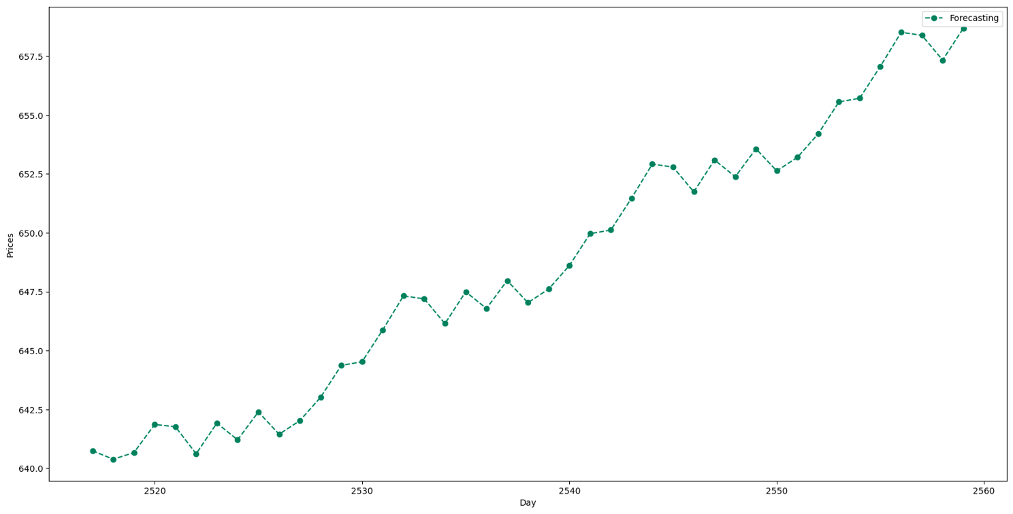
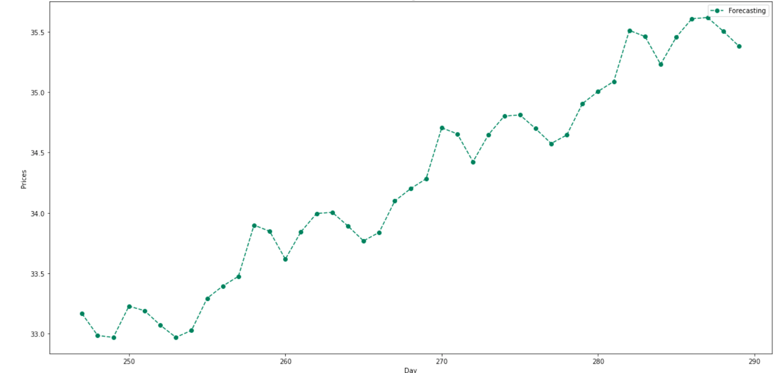
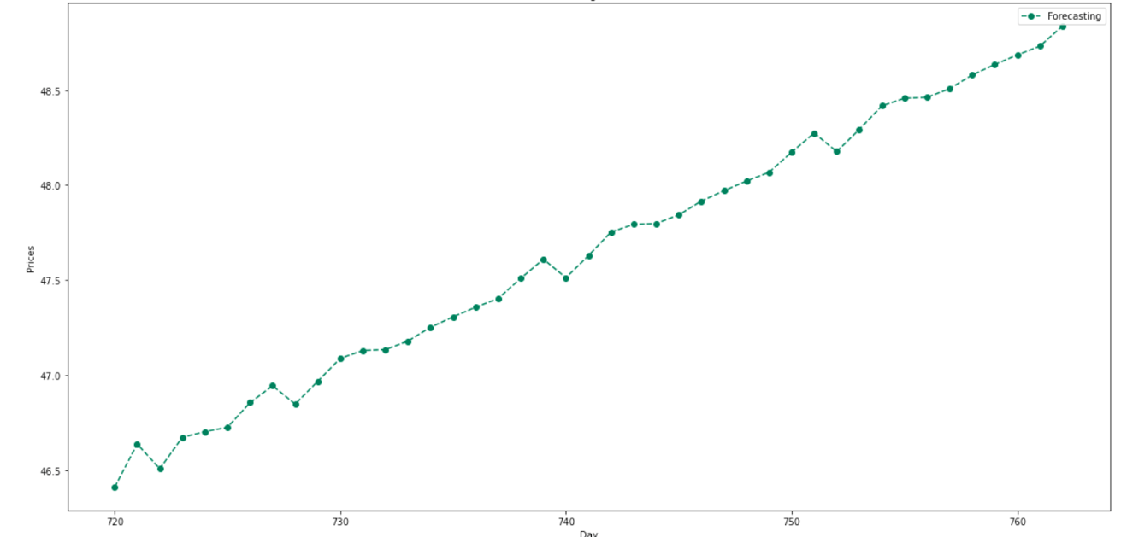
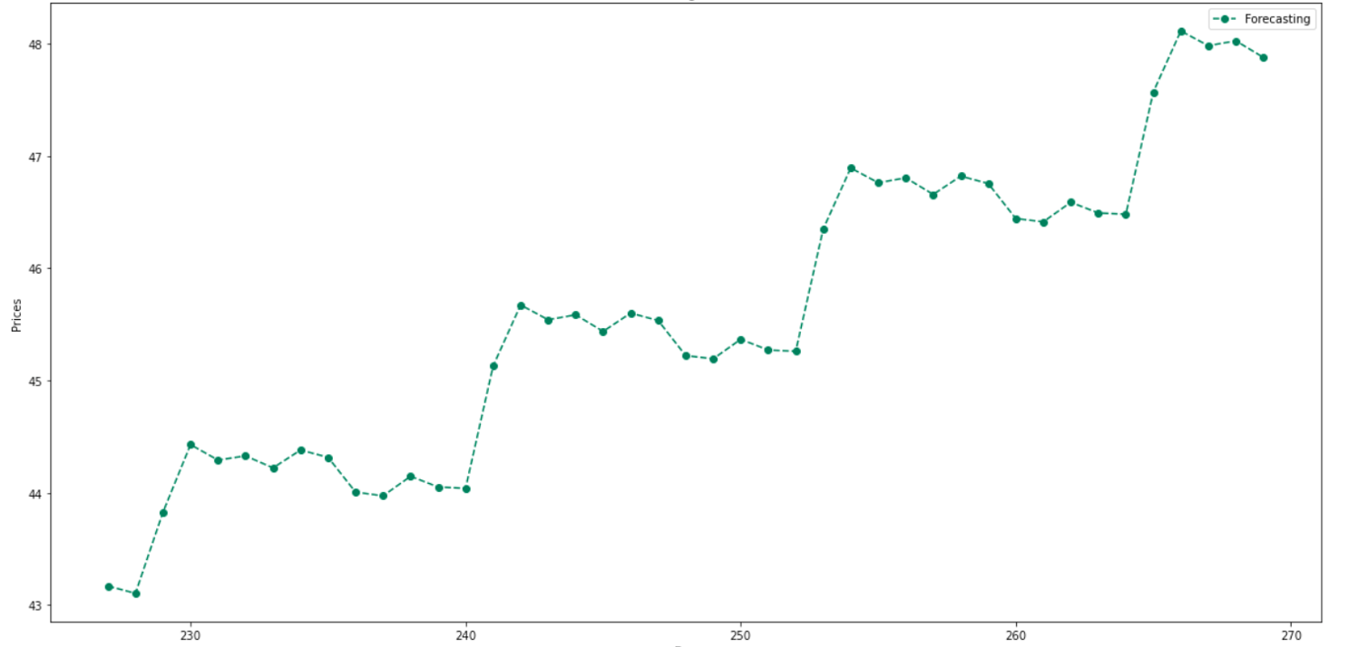
Forecasts
TSLA 42 DAY STOCK FORECAST
LI 42 DAY STOCK FORECAST
NIO 42 DAY STOCK FORECAST
XPEV 42 DAY STOCK FORECAST
17

Slide 18
Conclusions

Slide 19







Key Results & Deductions
All EV Stocks are forecasted to be trending higher
General Automotive market trend not included
Previous Short-term trend was currently up for all the EV stocks as well
General Stock market trend not included
Indication of short-term interest in all these stocks

Slide 20

Next Steps
General Market & Industry Inclusion
Stock trading Volume analysis
Publishing all inclusive results

Slide 21




Thank You
Brian Matsiko
https://www.linkedin.com/in/brianmat/
makryan77@gmail.com

